Slide 1
secure data hiding in images using steganogrphy
CAPSTONE PROJECT
Presented By:
Student Name : Gouri Gouthamchand Katariya
College Name & Department : Institute Of Aeronautical Engineering & Computer Science and Engineering

Slide 2
OUTLINE
Problem Statement
Technology used
Wow factor
End users
Result
Conclusion
Git-hub Link
Future scope

Slide 3
Problem Statement
In today's digital world, securing sensitive data during transmission is crucial. Traditional encryption methods may attract unwanted attention, making them susceptible to attacks. This project addresses this challenge by implementing image steganography, which hides confidential messages within images, ensuring secure and undetectable communication. By modifying the Least Significant Bit (LSB) of image pixels, this method enables safe data embedding without noticeable image distortion.

Slide 4
Technology used
Programming Language: Python
Libraries: OpenCV, OS
Encryption Method: Character Mapping using ASCII values
Steganographic Technique: Least Significant Bit (LSB) Modification
Platforms: Windows

Slide 5
Wow factors
Dual-Layer Security: Combines steganography with password protection for enhanced security.
Minimal Image Distortion: Ensures that the carrier image remains visually unchanged.
Lightweight and Fast: Simple and efficient implementation without complex dependencies.
Cross-Platform Compatibility: Works seamlessly on Windows, Linux, and macOS.
Automated Decryption: Extracts the hidden message accurately upon correct password entry.
User-Friendly Execution: Requires minimal technical knowledge to encode and decode messages.

Slide 6
End users
Government agencies for secure communication.
Banks for securing financial and transactional information.
Journalists and activists for confidential data transfer.
Corporate firms for sensitive document sharing.
Individuals seeking private communication.

Slide 7
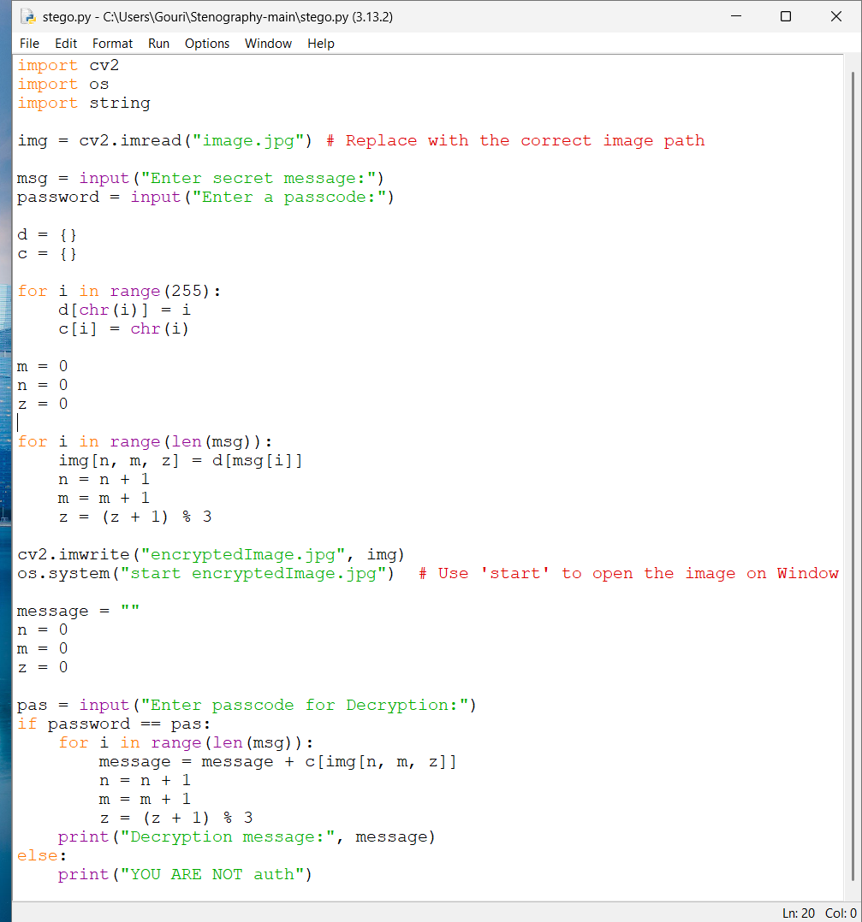
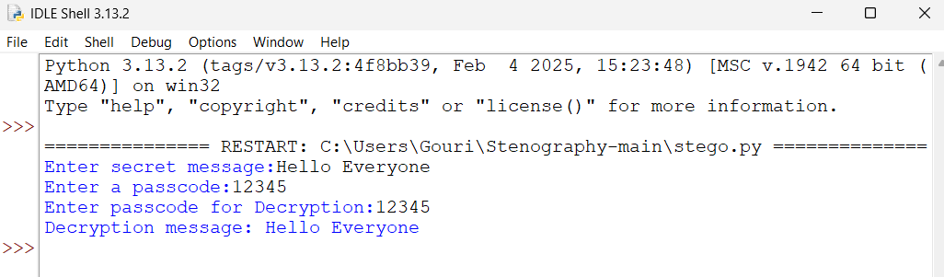
Results

Slide 8
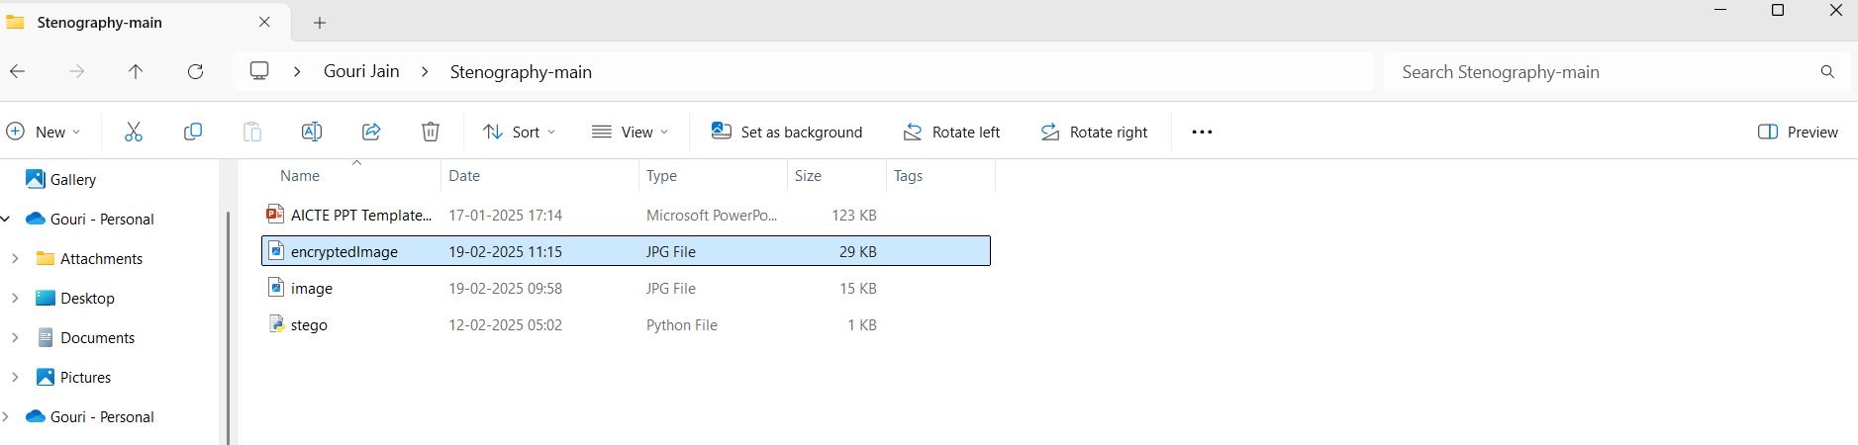
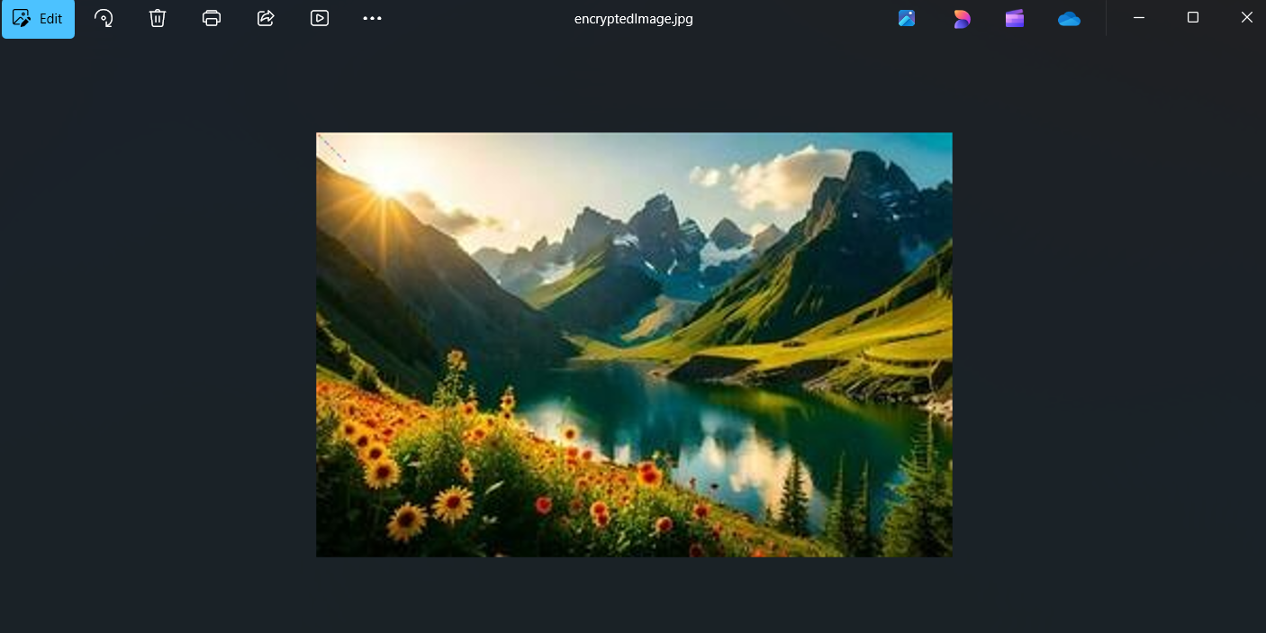
Results

Slide 9
Conclusion
This project successfully demonstrates how steganography can be leveraged to conceal sensitive information within images while preserving visual integrity. By incorporating password protection, it ensures that only authorized users can decrypt the hidden message, enhancing security. The lightweight and efficient implementation makes it suitable for various real-world applications, from secure communication to corporate data protection. With further improvements, such as advanced encryption techniques and multi-format support, this solution can be expanded to offer even greater security and versatility.

Slide 10
GitHub Link
https://github.com/GouriJain17/secure-data-hiding-in-images-using-steganogrphy.git

Slide 11
Future scope(optional)
Enhanced Security: Implementing advanced encryption techniques such as AES/RSA.
Multi-Format Support: Extending steganography to audio and video files.
AI-based Optimization: Using machine learning for intelligent pixel selection.
Cloud Integration: Secure data storage and transmission over cloud services.
Mobile Application: Developing a mobile-based steganography tool for on-the-go encryption.

Slide 12
THANK YOU

